Slide 1
Robertsonian Translocations

Slide 2
Fusion of two acrocentrics
Five acrocentrics: 13,14,15,21,22
Rob Trans are among the most common balanced structural rearrangements seen in the general population with a frequency in newborn surveys of about 1 in 1000
The most important are the ones involving 21, constitutes the bases of most familial translocation Down syndrome
14 and 15 contain imprinted genes
Short description: 45,XX,rob(14q21q)
Formal designation: 45,XX,der(14;21)(q10;q10)
or 45,XX,rob(14;21)(q10;q10)

Slide 3
Most balanced Rob trans involve different chromosomes (heterologous or nonhomologous translocation)
Fusion of homologs (homologous translocation)
rob(13q14q) is the most common (~75% or all Rob trans) – the commonest single chromosome rearrangement in the human race (1 in 1,300 are carriers)

Slide 4
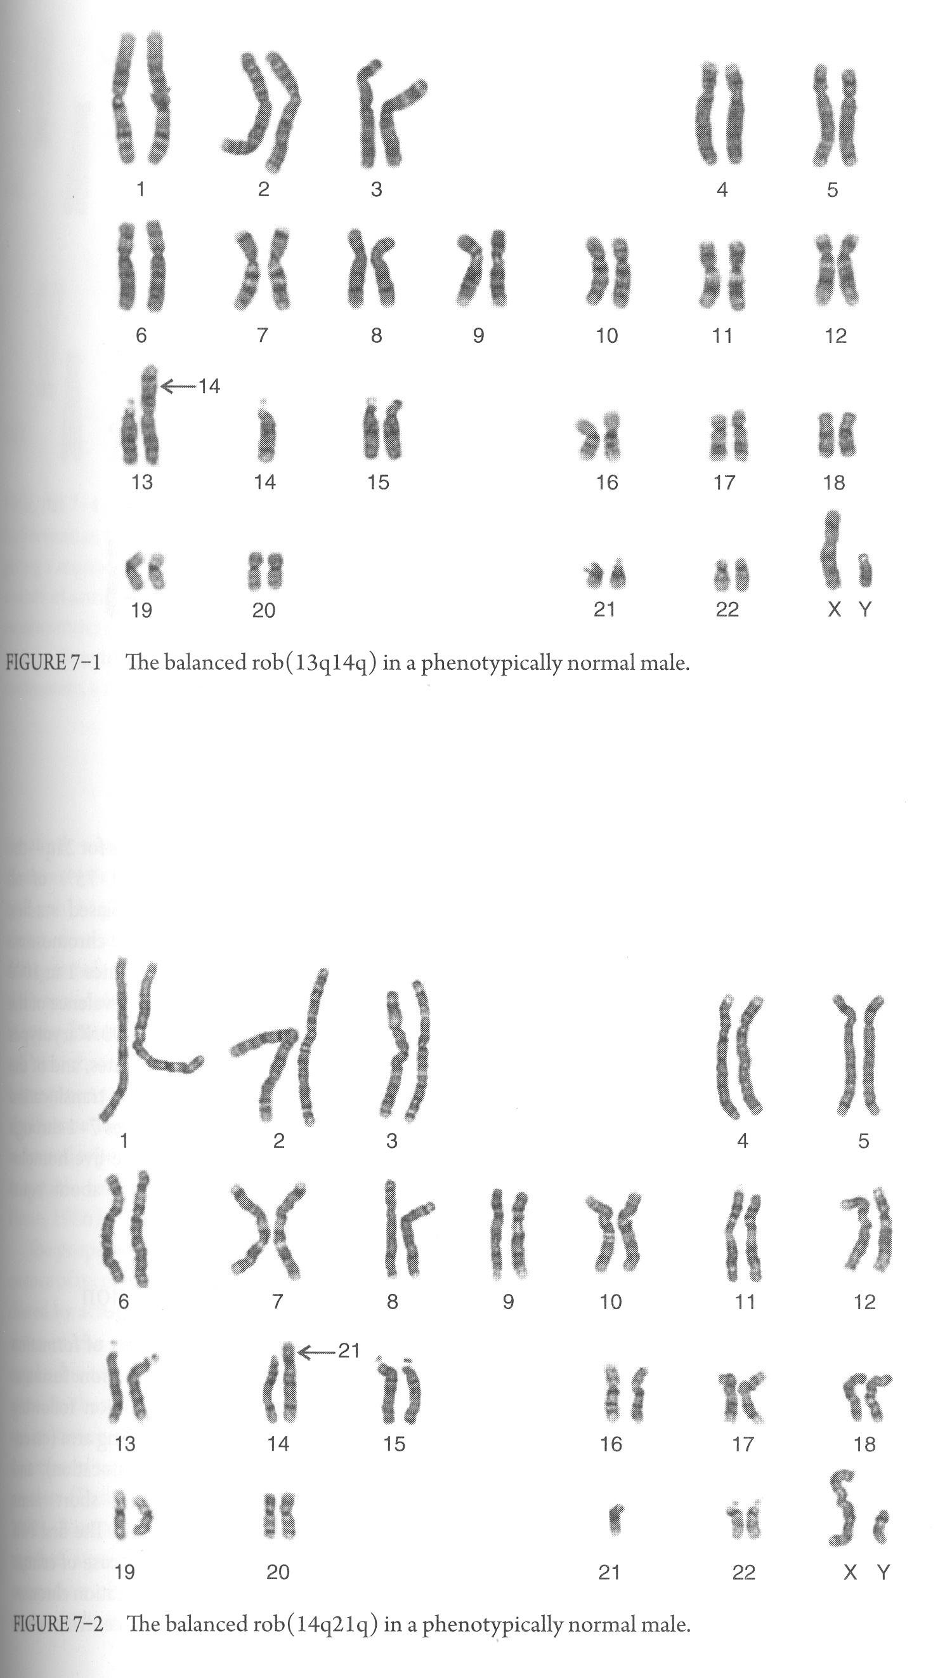

Slide 6
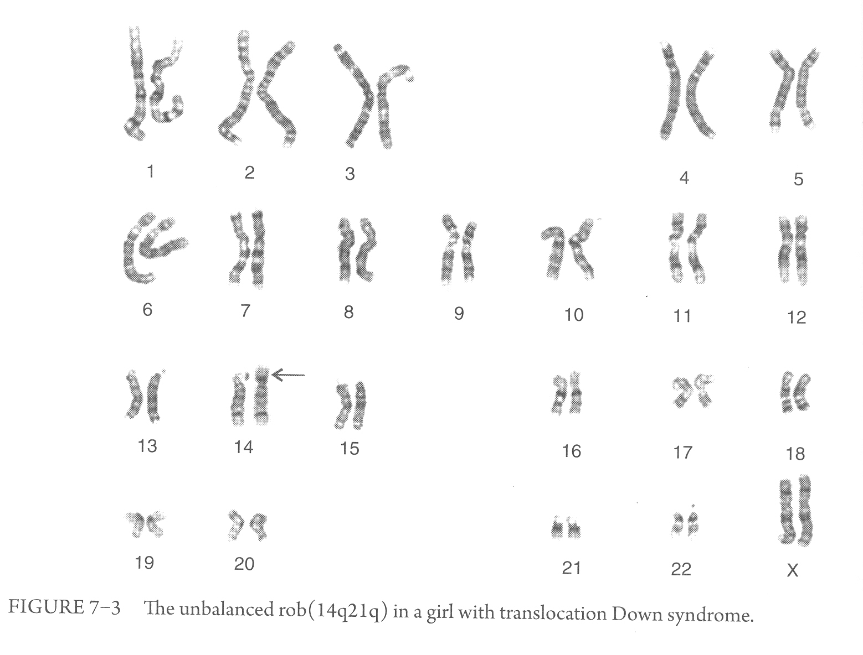

Slide 7
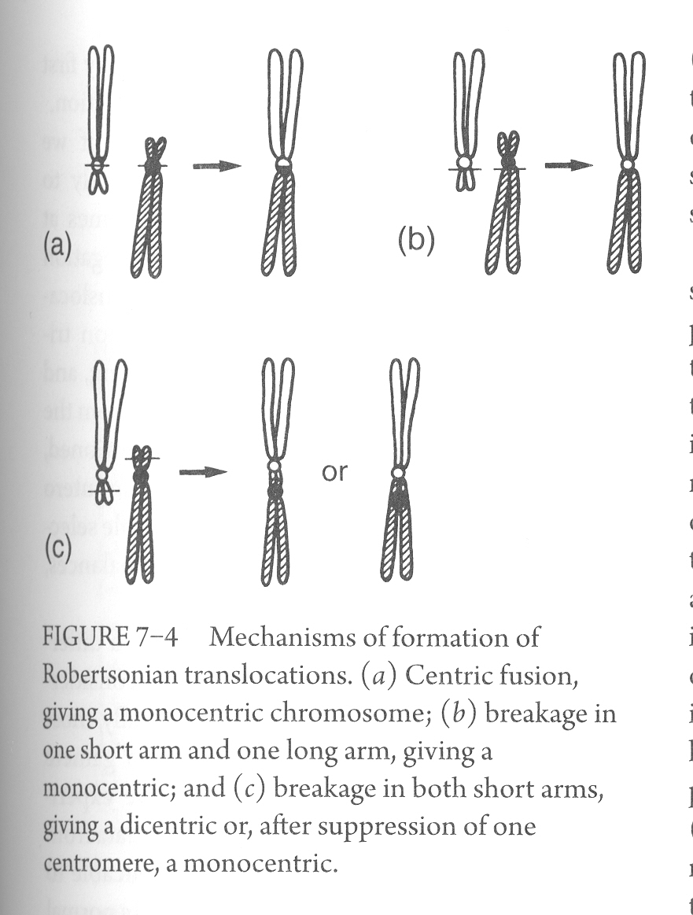
Most common mechanism of formation

Slide 8
Nucleolar organizing regions (NORs) are located in the “stalks” of the short arms of acrocentric chromosomes, and compromise multiple copies of genes coding for rRNA
Not all NORs are active, most individuals have four to seven per cell that are functioning

Slide 9
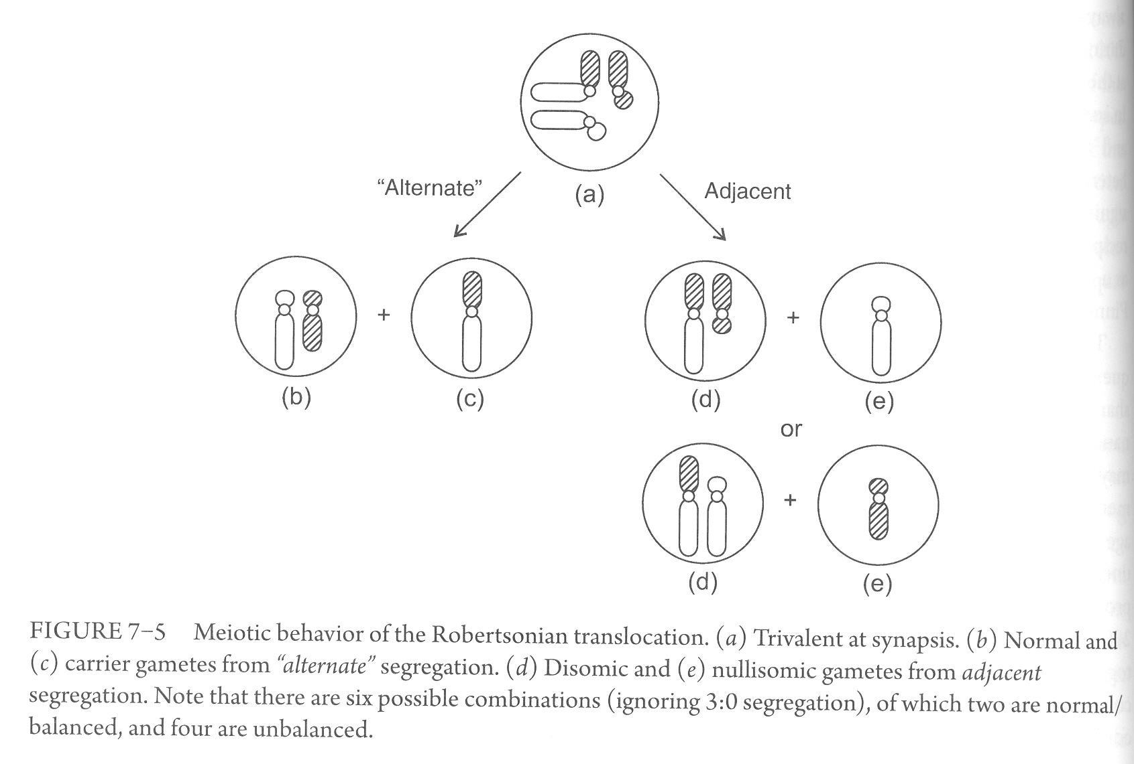
Only unbalanced conceptuses trisomic for 13 or 21 can survive

Slide 10
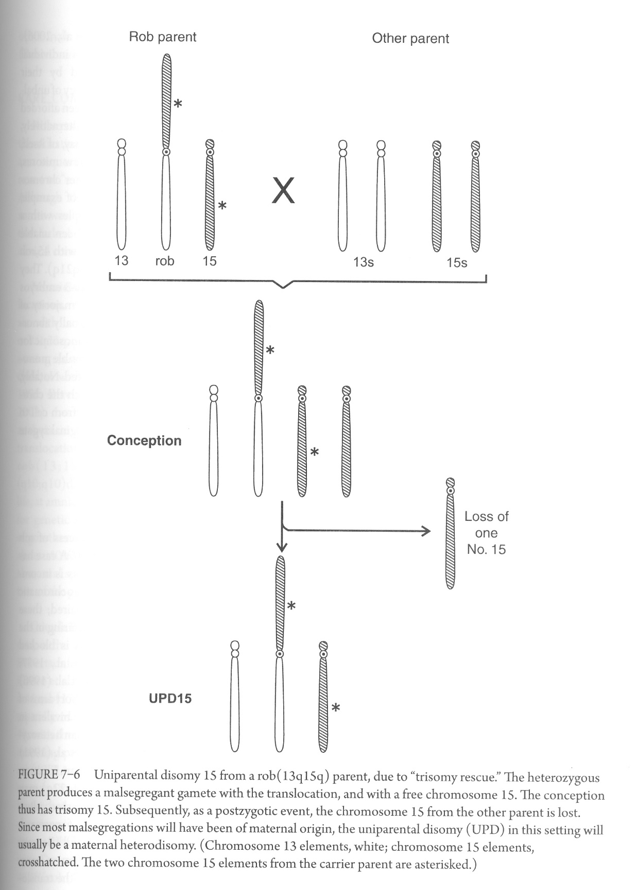
Postzygotic trisomic correction and associated uniparental disomy
Chr. 14,15
upd(14)mat (Temple syndrome)
upd(14)pat (Kagami-Ogata syndrome)
upd(15)mat (Prader-Willi syndrome)
upd(15)pat (Angelman syndrome)

